Slide 1
Play It Safe or Go Ballistic?
Alexis Barroso (ENtoFR)
Creative Freedom in Game Translation

Slide 2
Concepts defined by Ryosuke-san
Literal translation
Creative translation
Deliberate literal | Deliberate creative
Defensive literal | Defensive creative

Slide 3
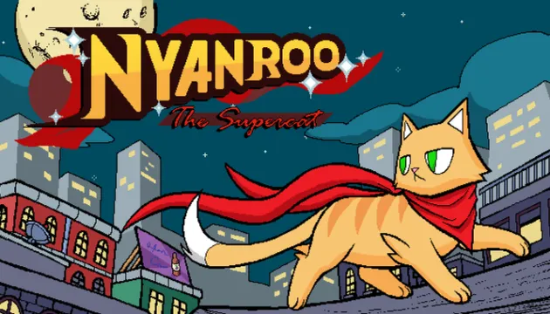
To clarify and illustrate these concepts, we will study examples taken from my translation of the indie game ‘Nyanroo the Supercat’
EARLY ACCESS

Slide 4
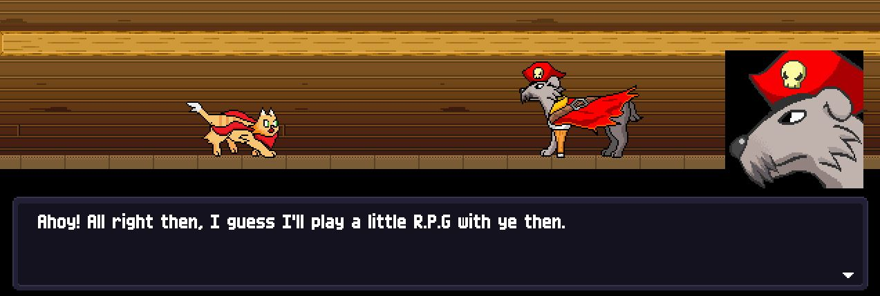
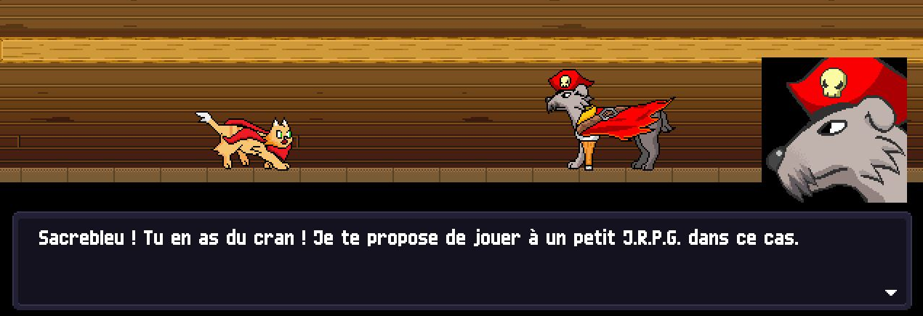
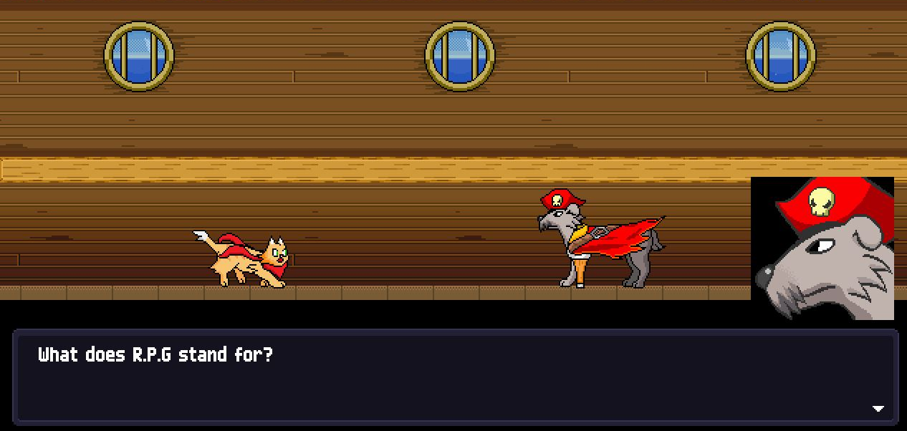
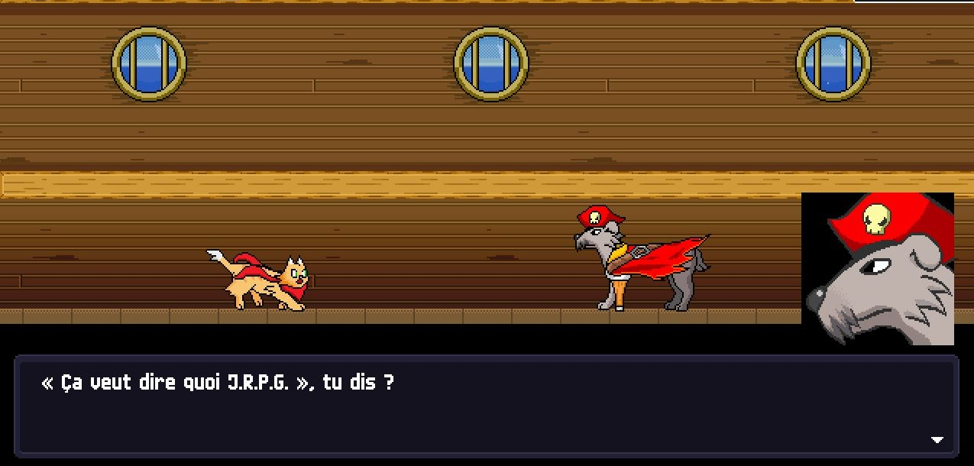
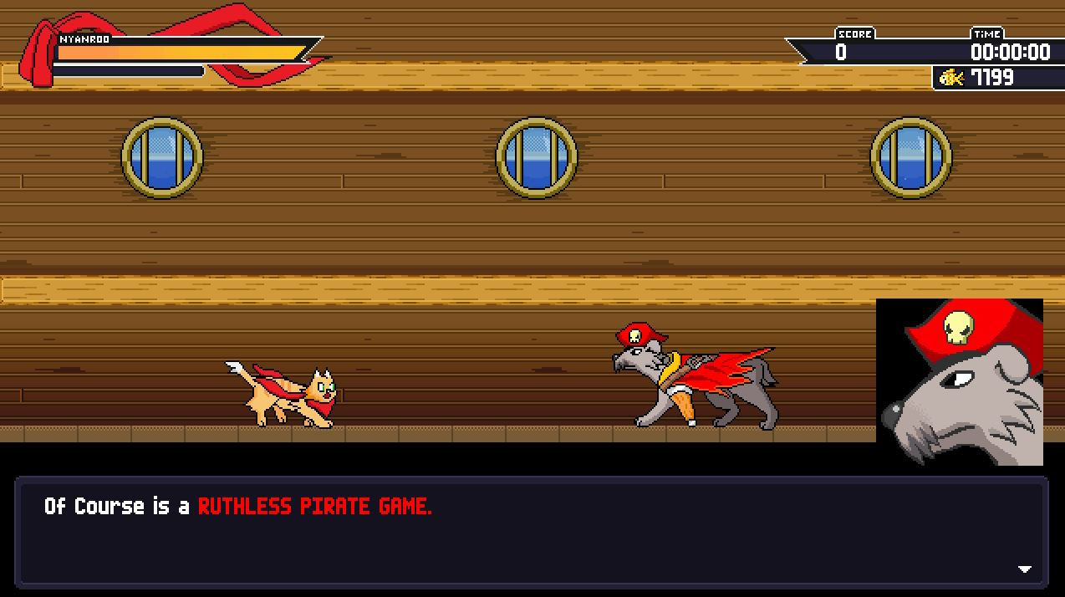
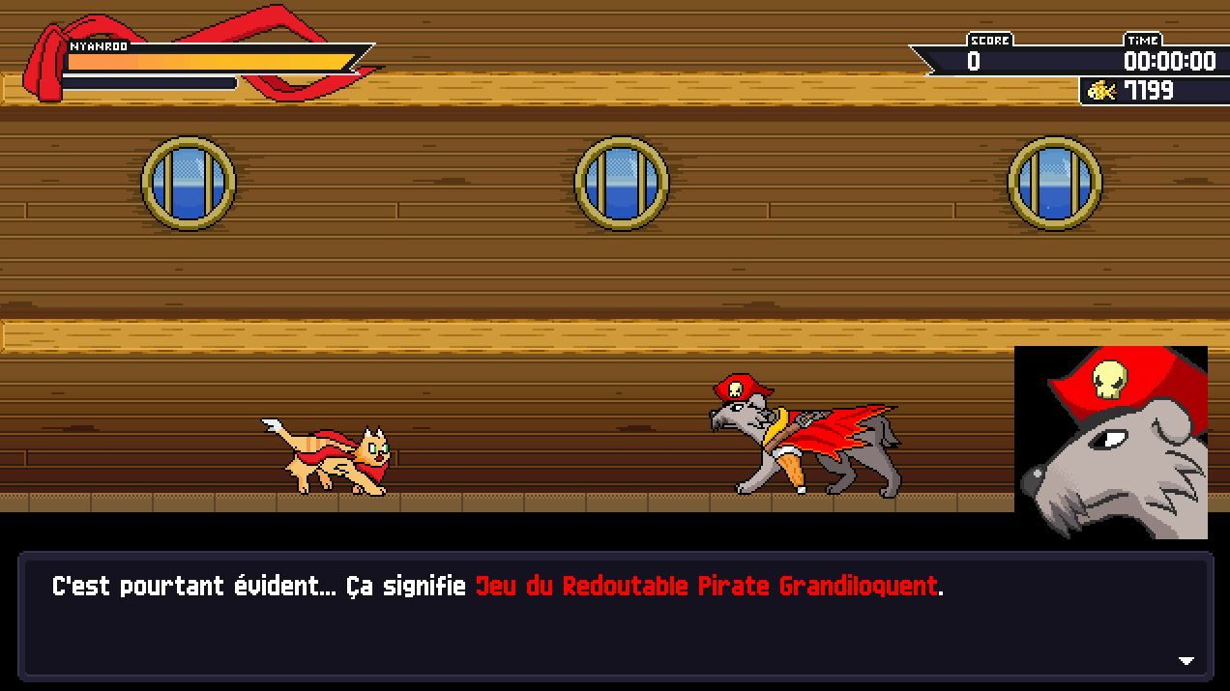
Deliberate creative translation (1)
Acronym adaptation
You confidently go ballistic and deviate from the source language, usually with dev/client approval (and sometimes even encouragement), and the resulting player experience is "better" in some way than a safe/literal translation.
“Sacrebleu! You’ve got guts! I have no choice but to offer your to play a little JRPG.”
“What does J.R.P.G stand for, you say?”
“It’s quite obvious… It means Game of the Ruthlessly Grandiloquent Pirate.”

Slide 5
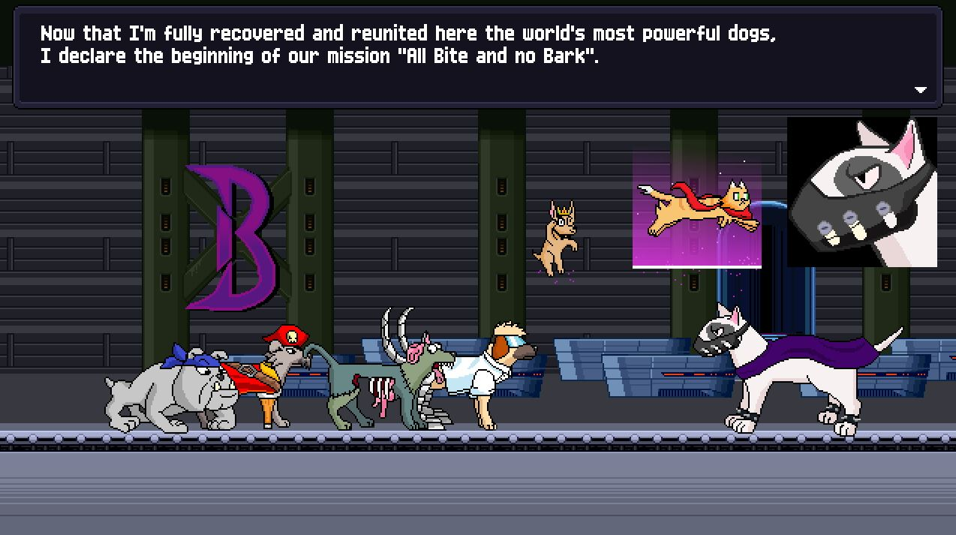
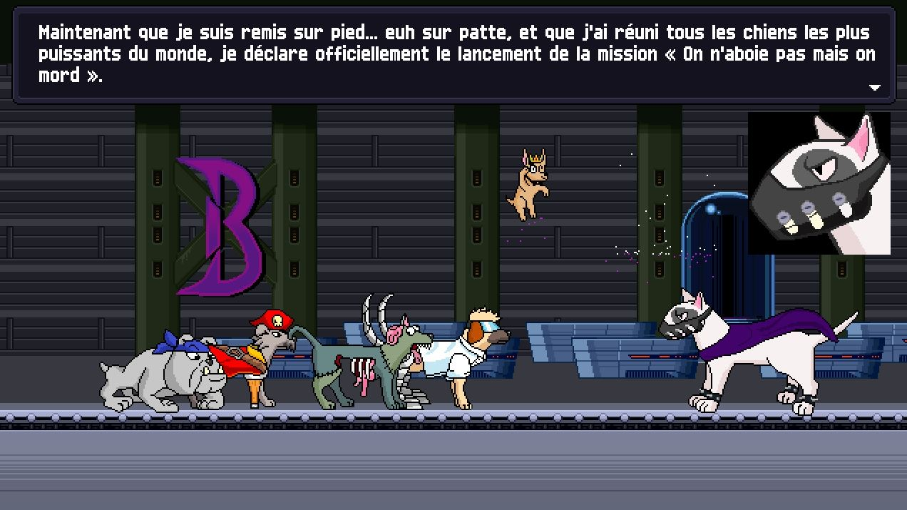
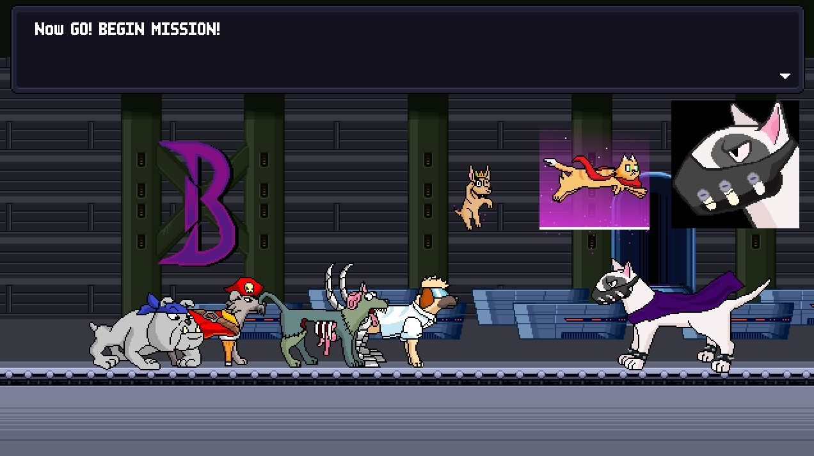
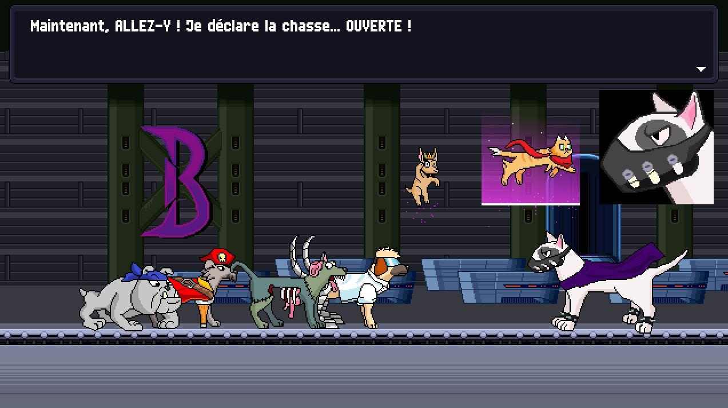
Deliberate creative translation (2)
Implementation of Jokes/Idioms
“Now that I am back on my feet… I mean on my paws [...]”
“Now, GO! I hereby declare the hunting season... OPEN!”

Slide 6
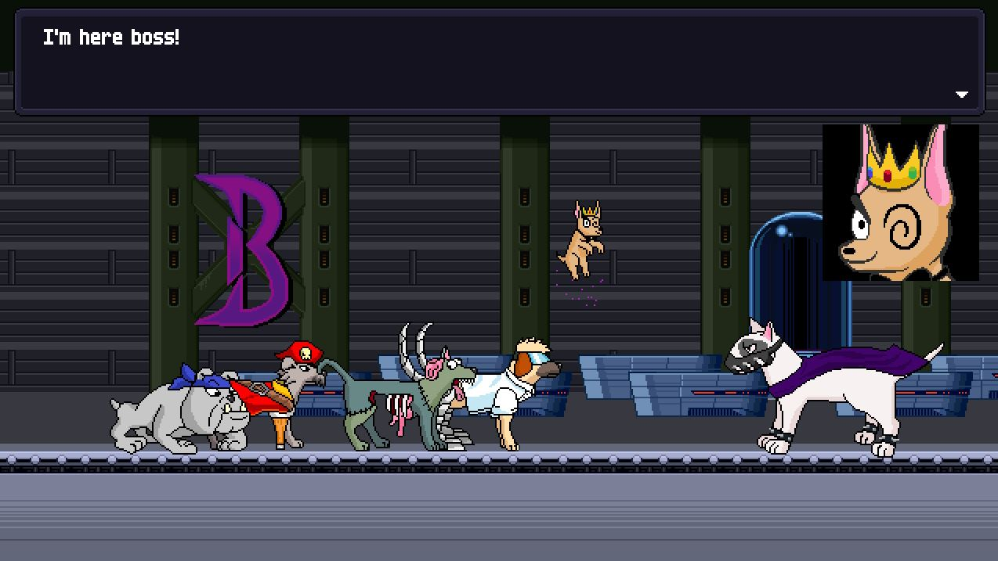
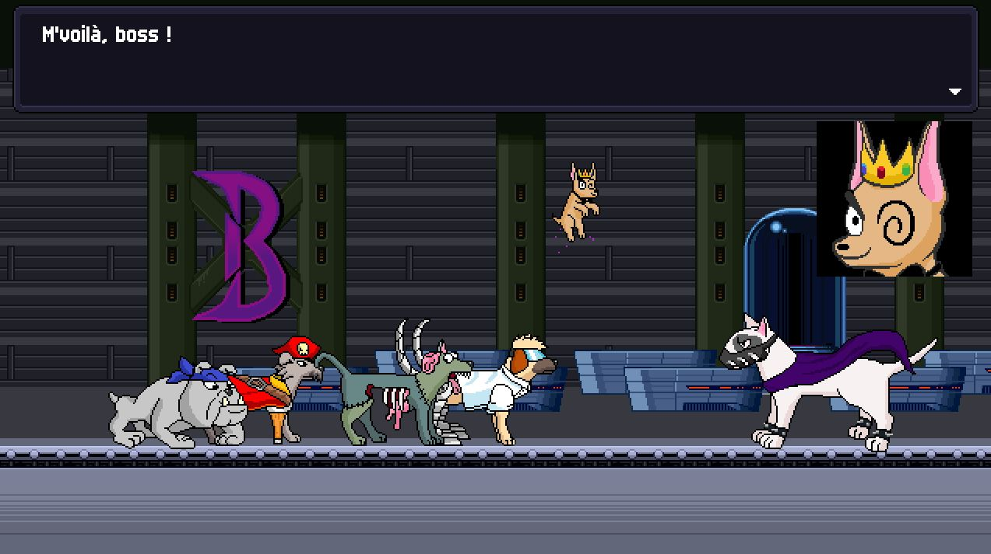
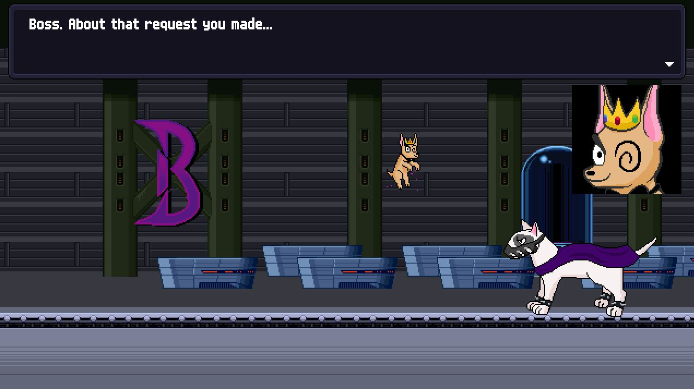
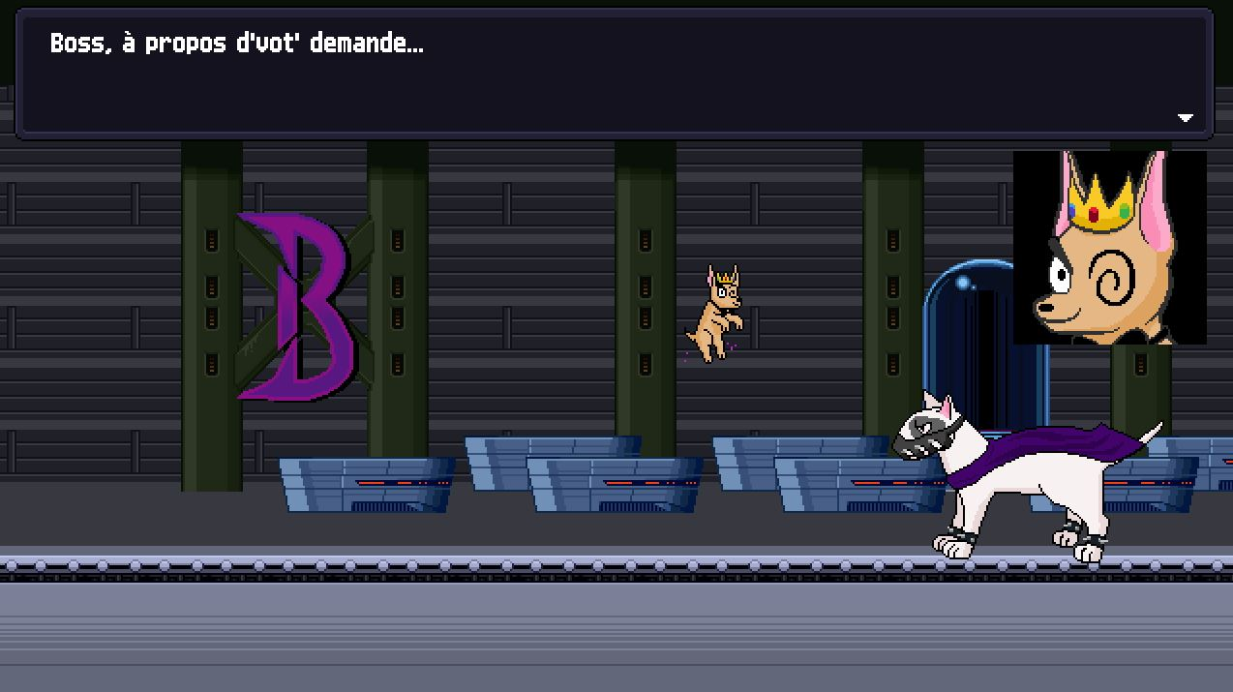
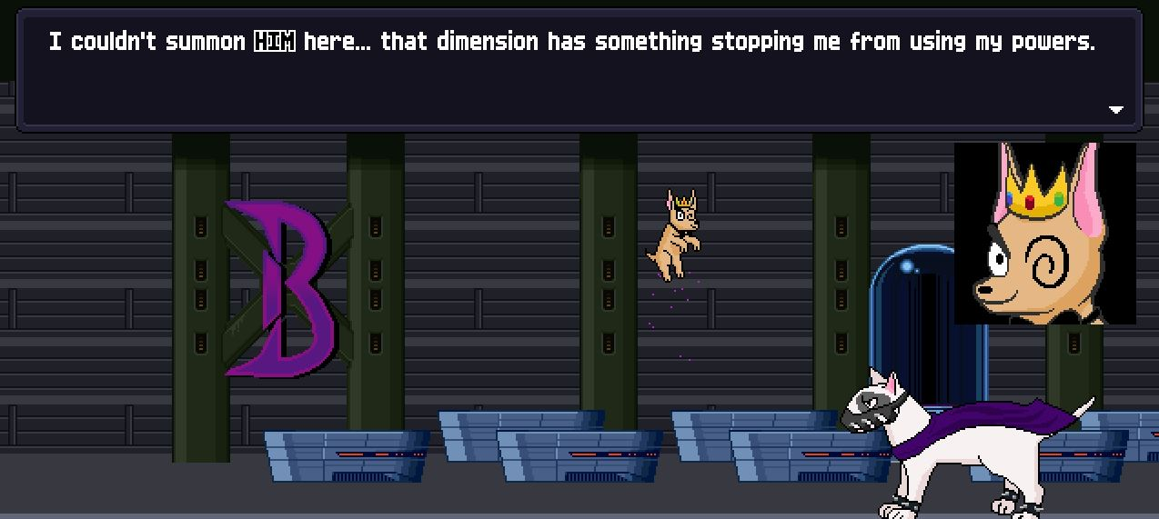
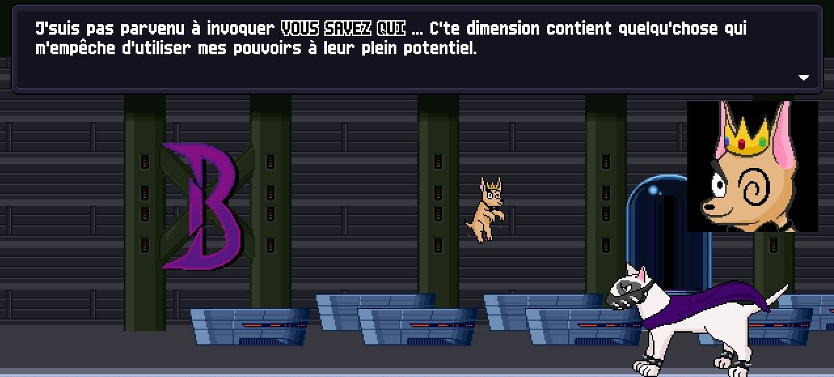
Deliberate creative translation (3)
Characterization
→ I made the character speak in a peculiar way that would fit him. Here, I changed the stress pattern by adding contractions (shortening certain sounds)

Slide 7
Deliberate creative translation (4)
Name localization
Wordplay: Spy + eye
Literal translation: Espiœil (espion + œil)
Thanks to the image, I was able to make a bolder localization:

Slide 8
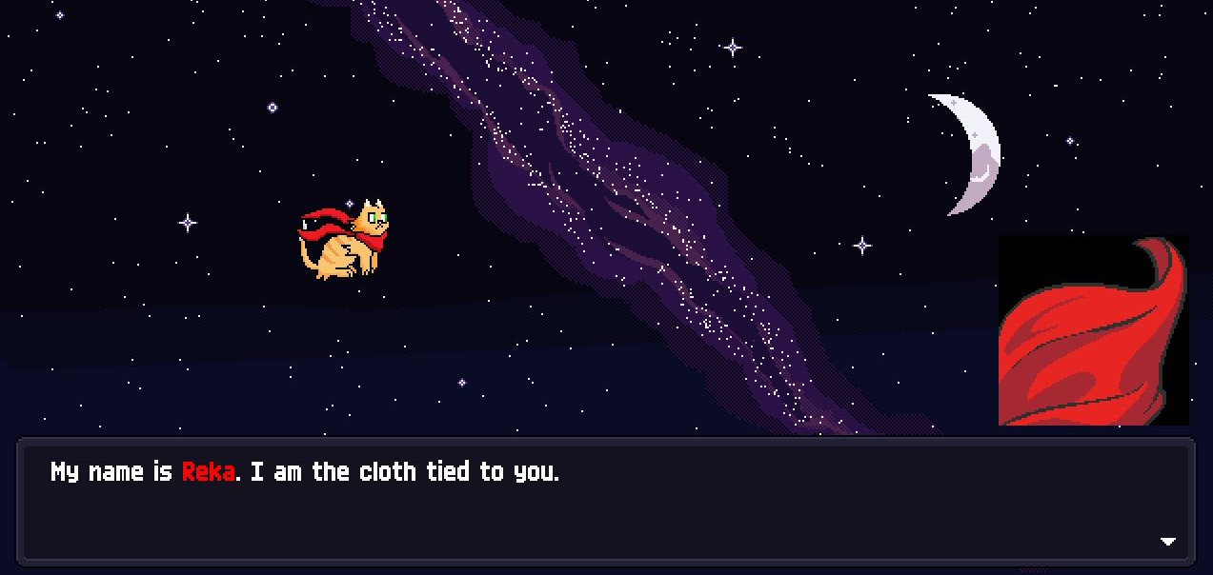
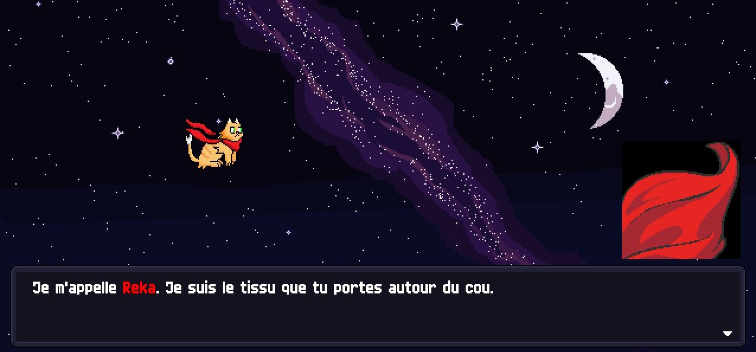
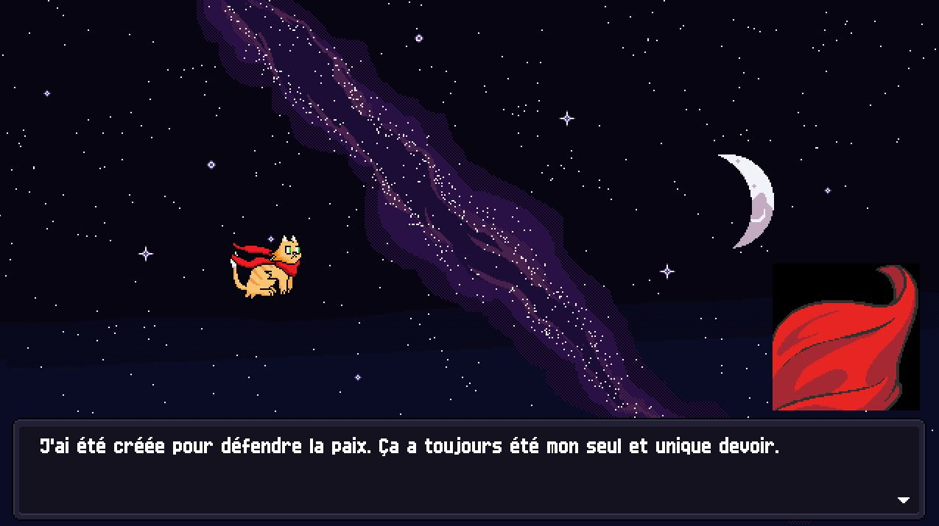
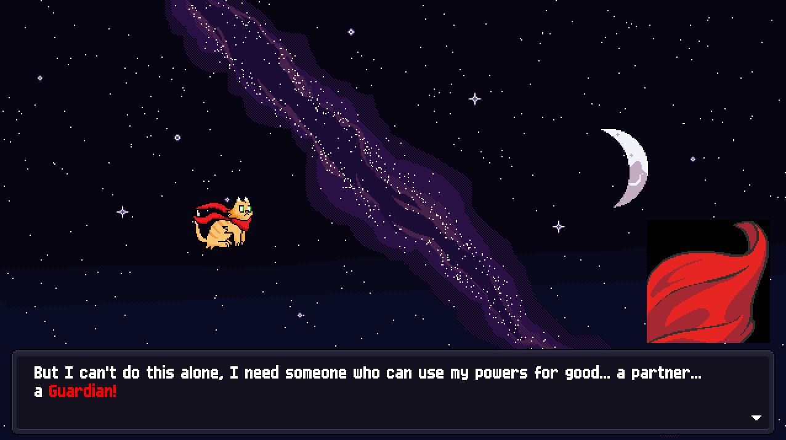
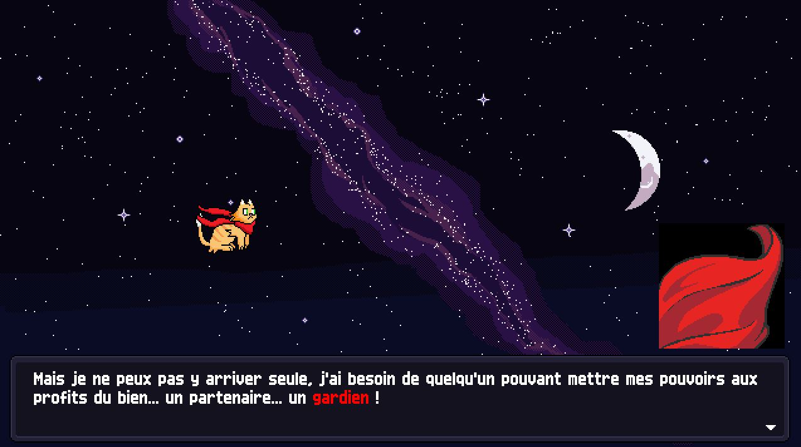
Defensive creative translation
un tissu // une étoffe
un textile // une écharpe...
You fuzzy up the context to avoid committing an outright mistranslation, e.g. you narrow down the context to two mutually exclusive possibilities, but find a wording that works for both, which might not necessarily be the ideal translation for each contextual possibility, but is a least-worst catchall that the player is unlikely to notice.
i.e., if we're unsure of a pronoun, we can often just leave it out, or work around mentioning it.

Slide 9
Defensive literal translation
You want to go creative, but it's too risky as you don't have enough contextual information to be sure of a possible creative decision.

Slide 10
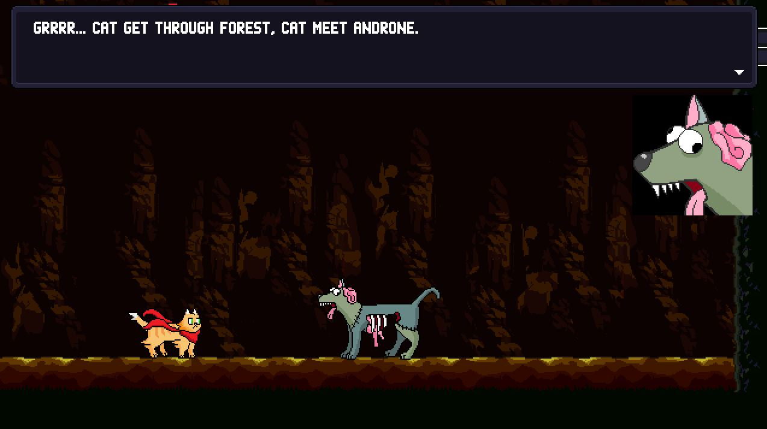
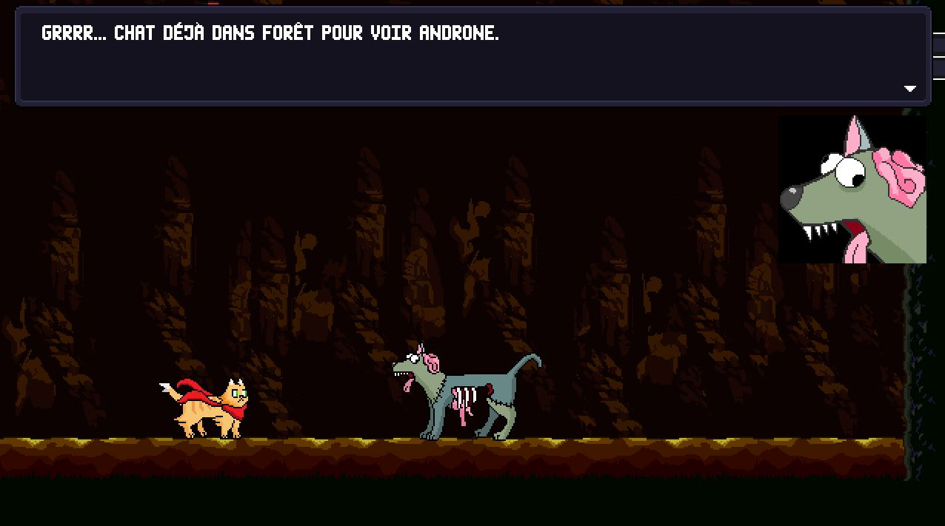
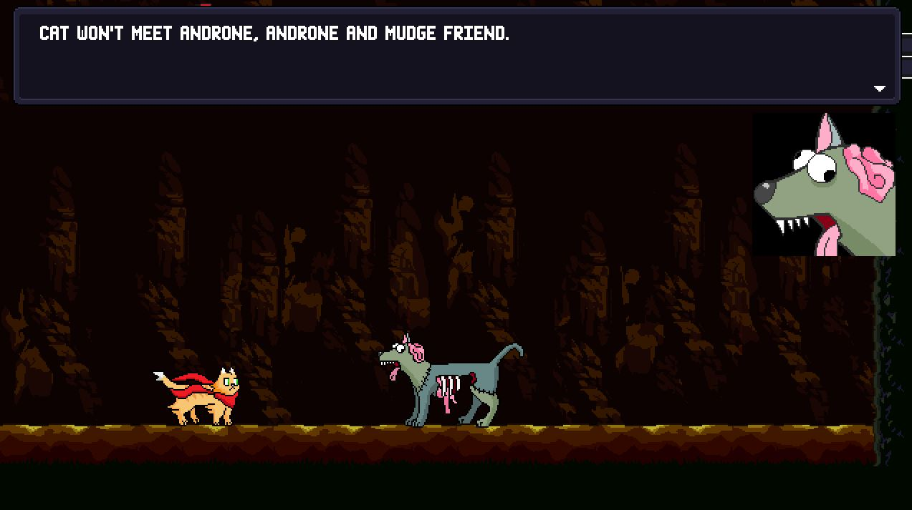
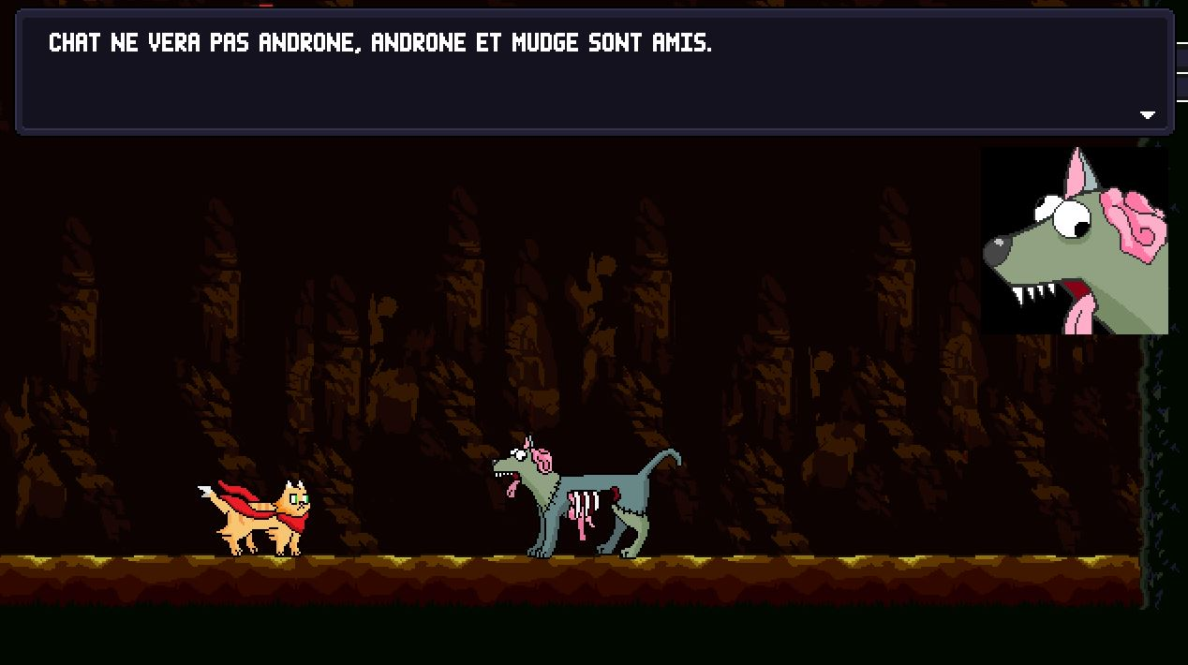
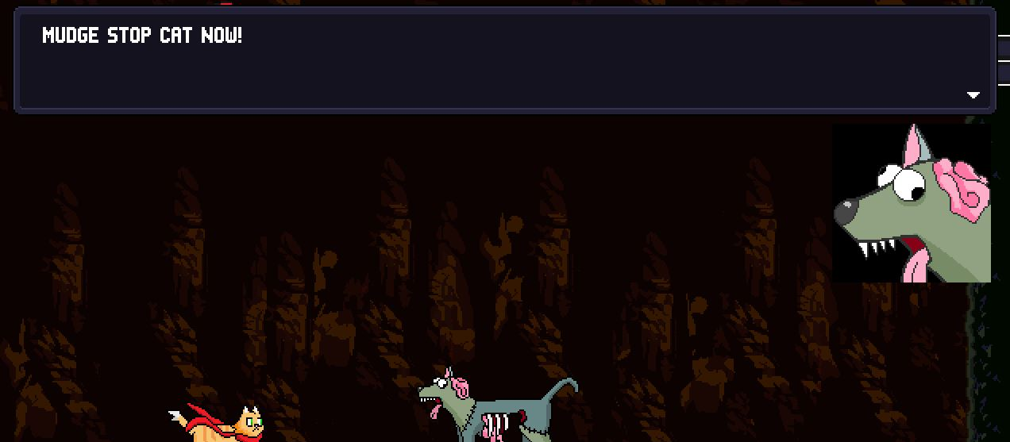
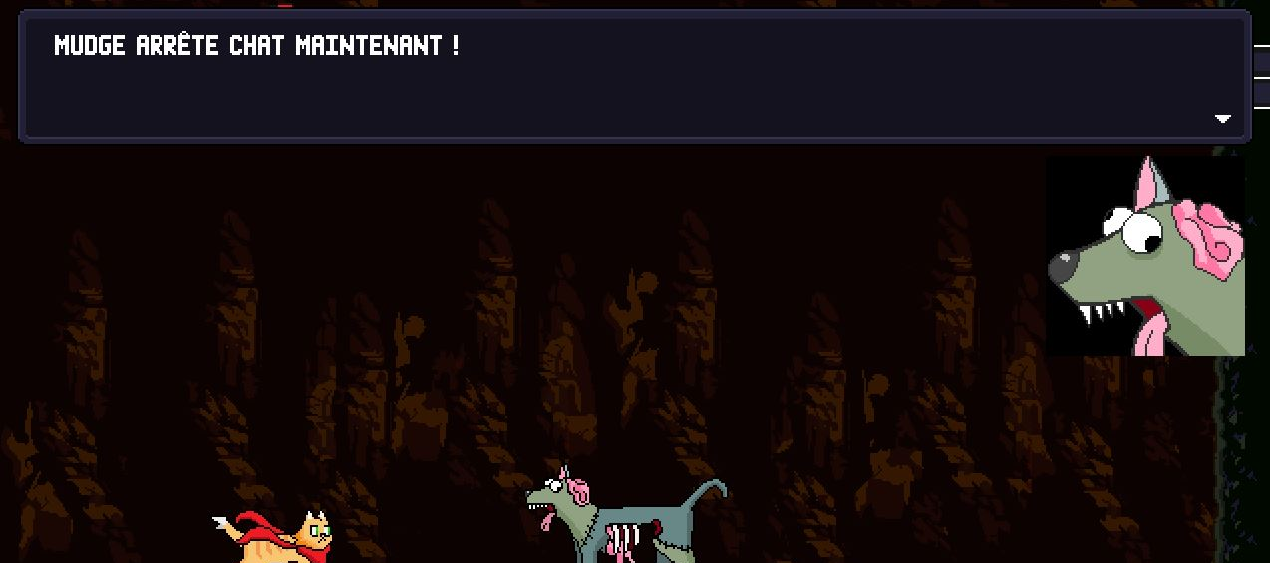
Deliberate literal translation (1)
Characterization
When a consciously literal translation is more effective, perhaps due to characterization and/or mise en scène

Slide 11
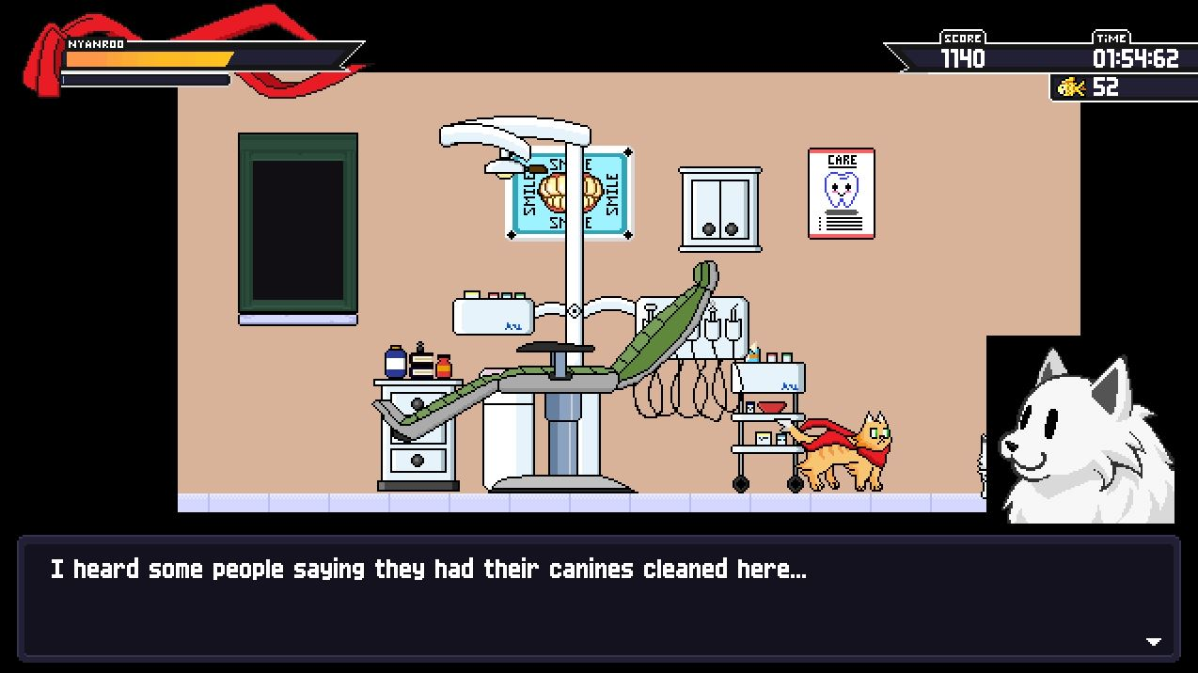
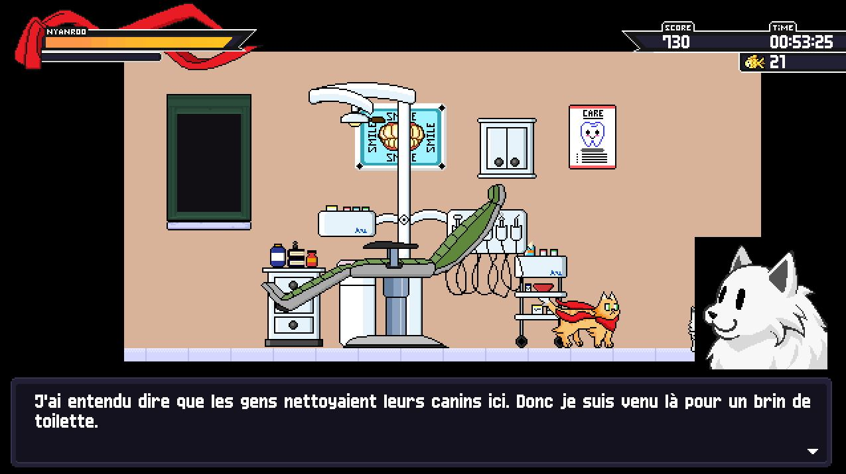
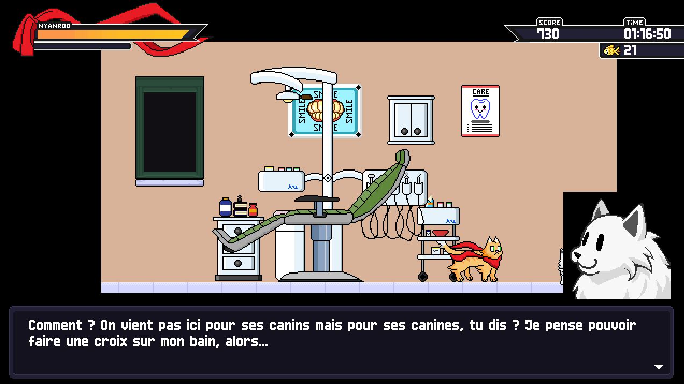
Deliberate literal translation (2)
Mise en scène
When a consciously literal translation is more effective, perhaps due to characterization and/or mise en scène
“What did you say? We come here to clean our canines (teeth), not canines (dog), you say? I’m gonna have to give up on my bath, then...

Slide 12
Why would you play it safe instead of going creative?
To sum up:
You don’t have sufficient information about the game (playable demo or reference files)
The developer told you not to take creative initiative and stick to the original wording (which is rare)
The literal translation can be more effective in specific cases.

Slide 13
Thanks for listening to my presentation!

